Slide 1
INFDEV016A Development 6A - Algoritmiek
Giulia Costantini
costg@hr.nl – Office H4.204

Slide 2
Course description in a nutshell
Why this course?
Algorithms + Data structures = Program
Prerequisite
Object oriented programming
Language for assignments
C#, F#, Haskell (supported), Scala (semi-supported)
In the lessons mainly pseudocode

Slide 3
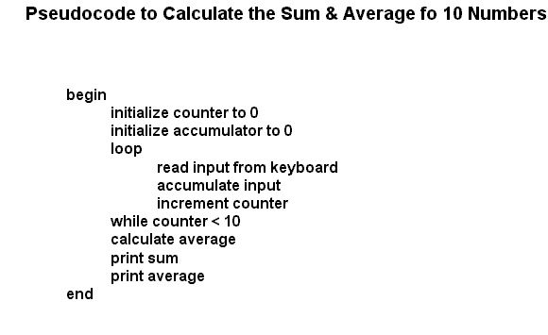
What is pseudo-code?
Informal description of a computer program
does not actually obey the syntax rules of any particular language
omits non-essential details
can include natural language

Slide 4
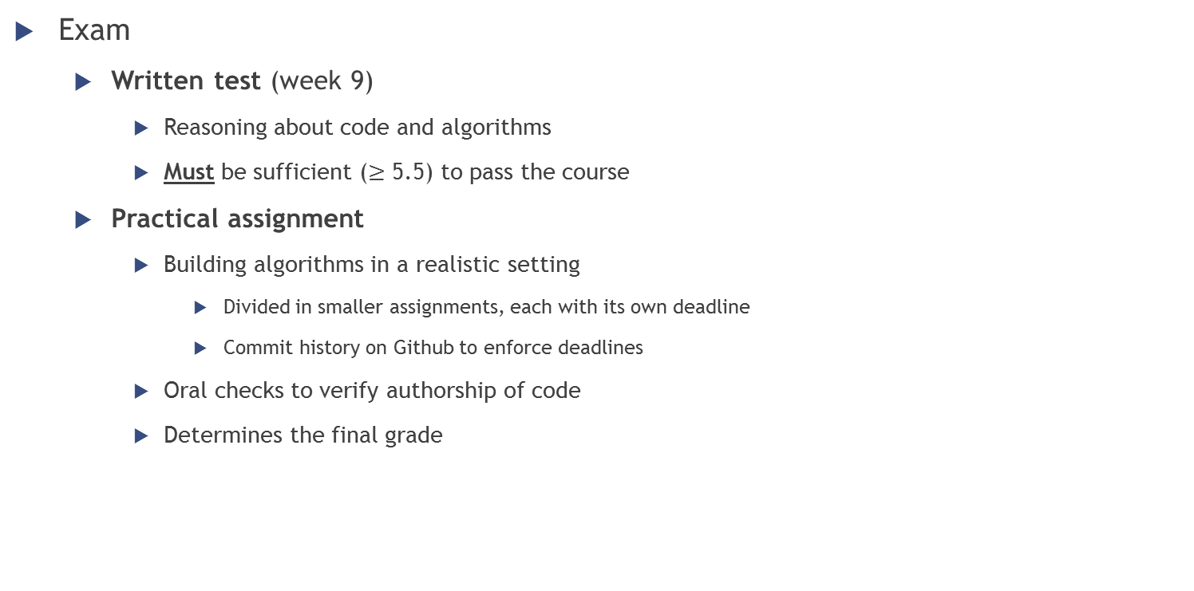
Assessment
Exam
Written test (week 9)
Reasoning about code and algorithms
Must be sufficient ($≥$ 5.5) to pass the course
Practical assignment
Building algorithms in a realistic setting
Divided in smaller assignments, each with its own deadline
Commit history on Github to enforce deadlines
Oral checks to verify authorship of code
Determines the final grade

Slide 5
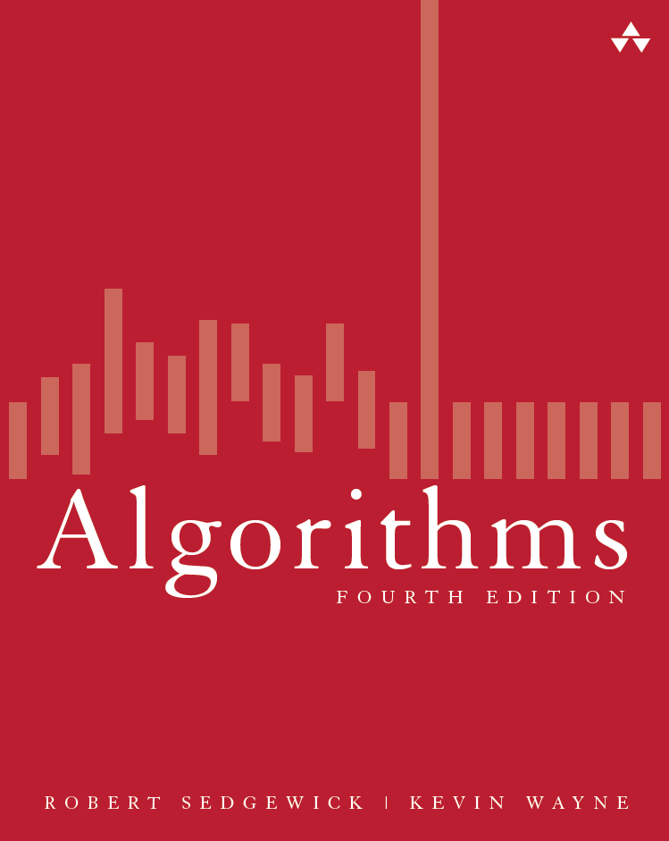
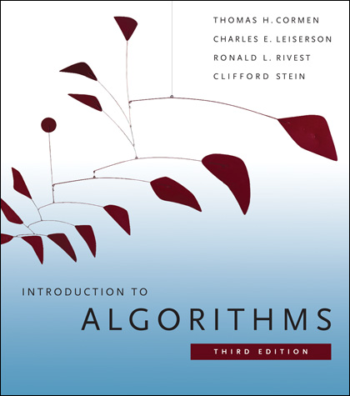
Literature
Algorithms, R. Sedgewick, K. Wayne, Addison Wesley, ISBN-13: 978-0321573513, 4th edition, 2011
Code and all examples in Java
http://algs4.cs.princeton.edu/
All lesson materials (slides, mainly): on N@tschool
FYI (not required):
Introduction to Algorithms, T. H. Cormen, C. Stein, R. L. Rivest, C. E. Leiserson, The MIT Press, ISBN: 978-0-262-53305-8, 3de editie, 2009
More complex, more complete and general
BIBLE OF ALGORITHMS AND EVERYTHING REMOTELY RELATED

Slide 6
Questions answered by the course
Why is my code slow?
Empirical and complexity analysis
How do I order my data?
Sorting algorithms
How do I structure my data?
Linear, tabular, recursive data structures
How do I represent relationship networks?
Graphs

Slide 7
Today
Why is my code slow?
Empirical and complexity analysis
How do I order my data?
Sorting algorithms
How do I structure my data?
Linear, tabular, recursive data structures
How do I represent relationship networks?
Graphs

Slide 8
More detailed agenda
Intro
Recap on arrays
Our first (simple) algorithms, operating on arrays
How to measure performance
Empirical analysis
Complexity theory

Slide 9
Arrays: a quick summary
Definition, Basic manipulation & properties, Search algorithms

Slide 10

Array
Definitions
Ordered list of values
Object that consists of a sequence of elements numbered 0, 1, 2, …
Each value has a numeric index
Index number
Array of size $N→$ indices from $0$ to $N−1$
0 1 2 3 4 5 6 7 8 9
79 87 94 82 67 98 87 81 74 91

Slide 11
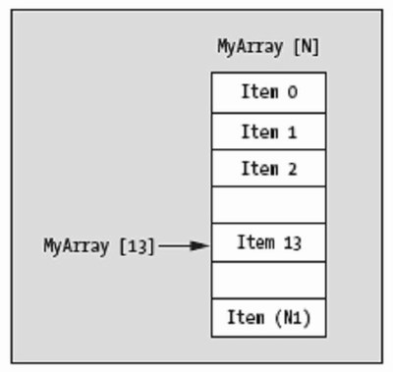
Array – Indexing notation
Access to elements through their index
Usually done with the subscript operator []
Very efficient because of cache alignment and tightness of representation (no additional data besides content)
NOT TRUE IN JAVA because of ref’s everywhere

Slide 12
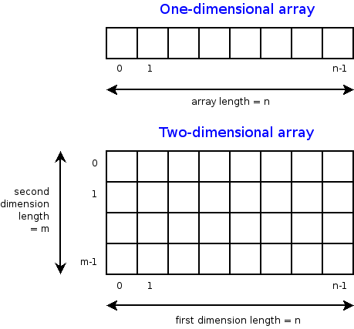
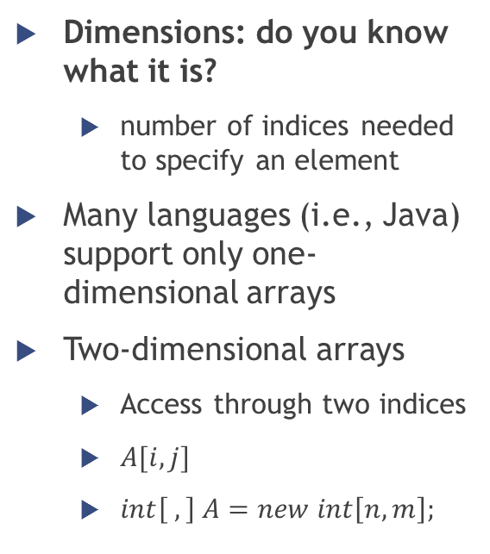
Multidimensional arrays
Dimensions: do you know what it is?
number of indices needed to specify an element
Many languages (i.e., Java) support only one-dimensional arrays
Two-dimensional arrays
Access through two indices
$A[i,j]$
$int\left[ ,\right] A=new int\left[n,m\right];$

Slide 13
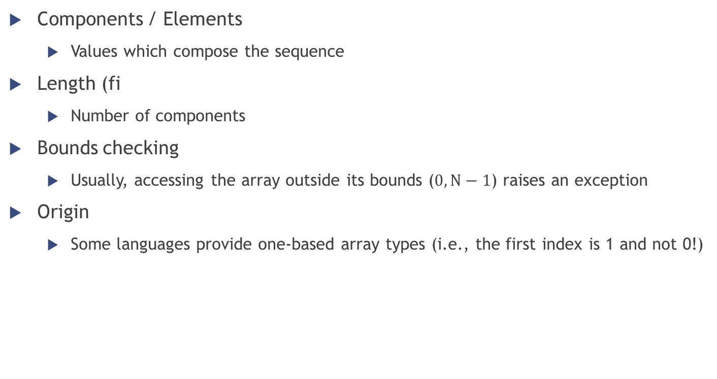
Array – Terminology, properties
Components / Elements
Values which compose the sequence
Length (fi
Number of components
Bounds checking
Usually, accessing the array outside its bounds ($0,N−1$) raises an exception
Origin
Some languages provide one-based array types (i.e., the first index is 1 and not 0!)

Slide 14
Array – Sequential search
Also called linear search
Simplest algorithm possible…
… but also least efficient!
Trade-off: simplicity or performance?
Examine each element sequentially, from the first one to the end of the array
Similar to looking for a passenger in a moving train

Slide 15

Array – Sequential search
Pseudo-code
Look for the value $v$ in the array $a$
Return -1 if $v$ is not found
FOR i = 0 TO N-1
IF a[i] = v
RETURN i
RETURN -1

Slide 16
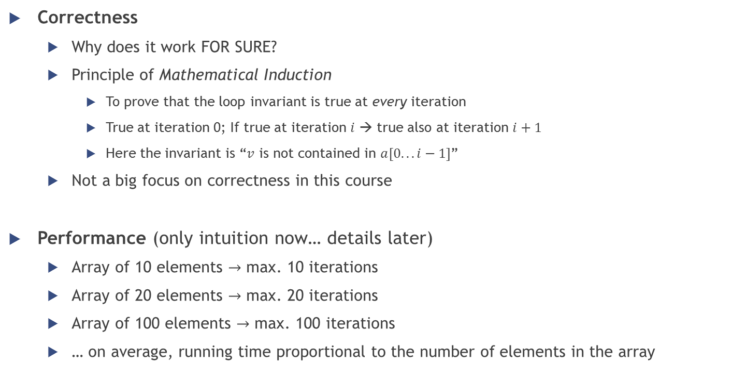
Array - Sequential search
FOR i = 0 TO N-1
IF a[i] = v
RETURN i
RETURN -1
Correctness
Why does it work FOR SURE?
Principle of Mathematical Induction
To prove that the loop invariant is true at every iteration
True at iteration 0; If true at iteration $i$ → true also at iteration $i+1$
Here the invariant is “$v$ is not contained in $a[0.. . i−1]$”
Not a big focus on correctness in this course
Performance (only intuition now… details later)
Array of 10 elements $→$ max. 10 iterations
Array of 20 elements $→$ max. 20 iterations
Array of 100 elements $→$ max. 100 iterations
… on average, running time proportional to the number of elements in the array

Slide 17
Array – Binary search
Standard search algorithm for a SORTED sequence
More efficient than sequential search
Requires the order of elements
Basic idea: divide the sequence in two and focus on the half which could contain the element
Application example: looking up a word in a dictionary

Slide 18
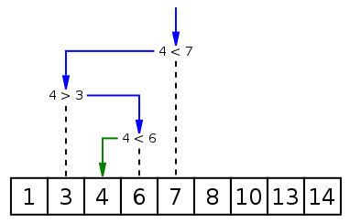

Array – Binary search
Pseudo-code [iterative version]
Look for the value $v$ in the array $a$
Return -1 if $v$ is not found
low = 0; high = N-1
WHILE low <= high
middle = (low + high) / 2
IF a[middle] > v
high = middle – 1
ELSE IF a[middle] < v
low = middle + 1
ELSE
RETURN middle
RETURN -1
low
middle
high

Slide 19
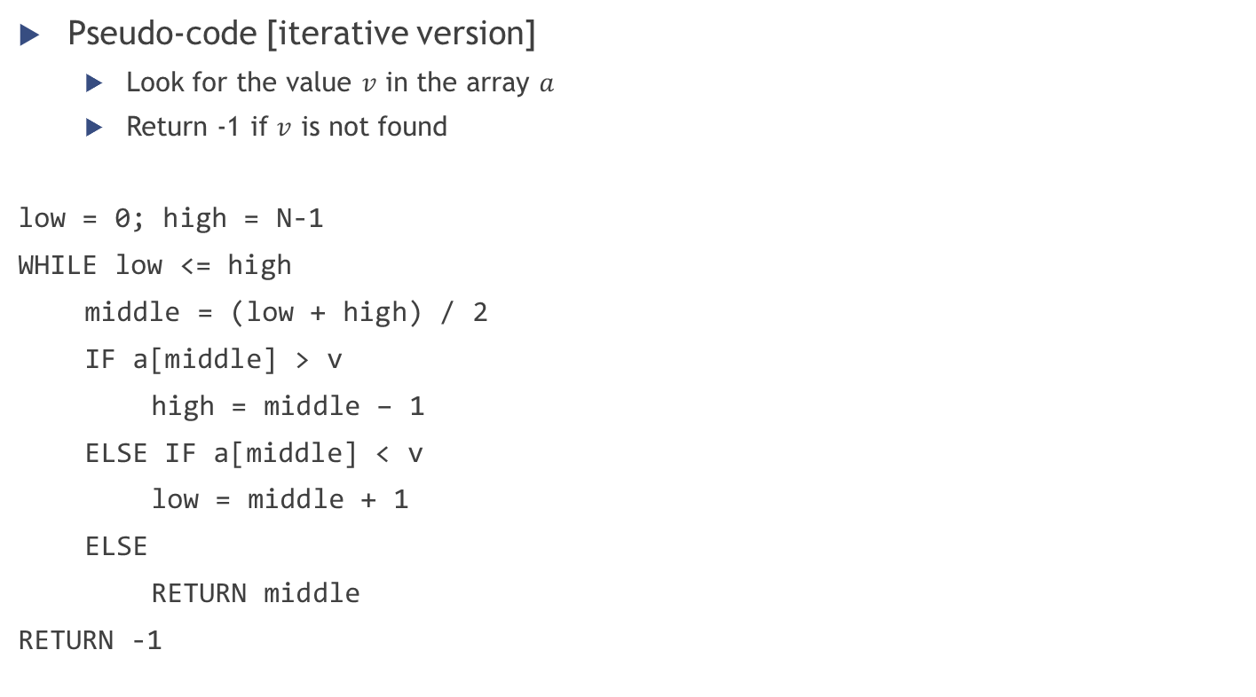
Array – Binary search
Pseudo-code [iterative version]
Look for the value $v$ in the array $a$
Return -1 if $v$ is not found
low = 0; high = N-1
WHILE low <= high
middle = (low + high) / 2
IF a[middle] > v
high = middle – 1
ELSE IF a[middle] < v
low = middle + 1
ELSE
RETURN middle
RETURN -1
low
middle
high

Slide 20

Array – Binary search
Pseudo-code [iterative version]
Look for the value $v$ in the array $a$
Return -1 if $v$ is not found
low = 0; high = N-1
WHILE low <= high
middle = (low + high) / 2
IF a[middle] > v
high = middle – 1
ELSE IF a[middle] < v
low = middle + 1
ELSE
RETURN middle
RETURN -1
low
high
middle

Slide 21
Array – Binary search
Pseudo-code [iterative version]
Look for the value $v$ in the array $a$
Return -1 if $v$ is not found
low = 0; high = N-1
WHILE low <= high
middle = (low + high) / 2
IF a[middle] > v
high = middle – 1
ELSE IF a[middle] < v
low = middle + 1
ELSE
RETURN middle
RETURN -1
low
high
middle

Slide 22
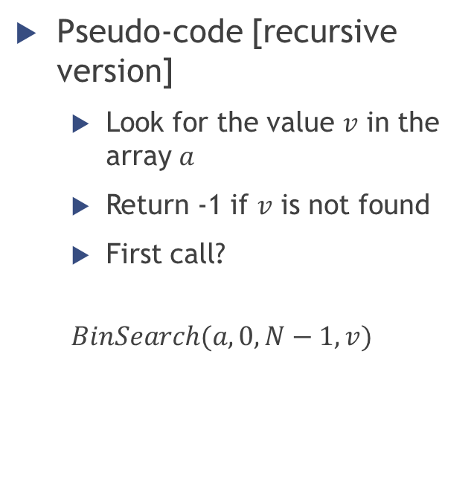
Array – Binary search
Pseudo-code [recursive version]
Look for the value $v$ in the array $a$
Return -1 if $v$ is not found
First call?
$$BinSearch(a, 0, N−1, v)$$
BinSearch(a, low, high, v)
IF low > high
RETURN -1
middle = (low + high) / 2
IF a[middle] > v
BinSearch(a, low, middle – 1, v)
ELSE IF a[middle] < v
BinSearch(a, middle + 1, high, v)
ELSE
RETURN middle

Slide 23

Array – Binary search
Performance
More complex to determine than in linear search
Given the number of elements $N$ in the array, how many iterations will be done at most by the loop?

Slide 24
Performance of algorithms
Empirical analysis; Complexity theory

Slide 25
Studying algorithms
Intuition
How does it work?
Invariant (correctness)
Why does it work? What are the fundamental properties that guarantee the correct answer?
Complexity
How fast is it, and how does it scale to very large inputs?
Through observation … Empirical analysis
Through reasoning … Complexity analysis

Slide 26
Empirical analysis

Slide 27

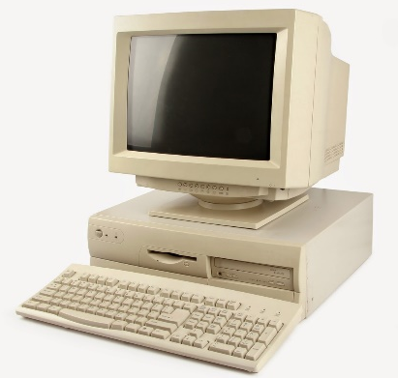

Empirical analysis
How to make quantitative measurements of the running time of our programs?
Using the Stopwatch!
If we execute a program more than once and/or on different machines, will it always have the same running time?
No!!! It depends on…
The PC on which it is executed
The “problem size”
Notes:
Problem size: size of the input / value of a command-line argument

Slide 28
Empirical analysis
More interesting question:
“How much does the running time of a program increase when the problem size increases?”
We look for a dependency/relationship between
Problem size
Running time

Slide 29
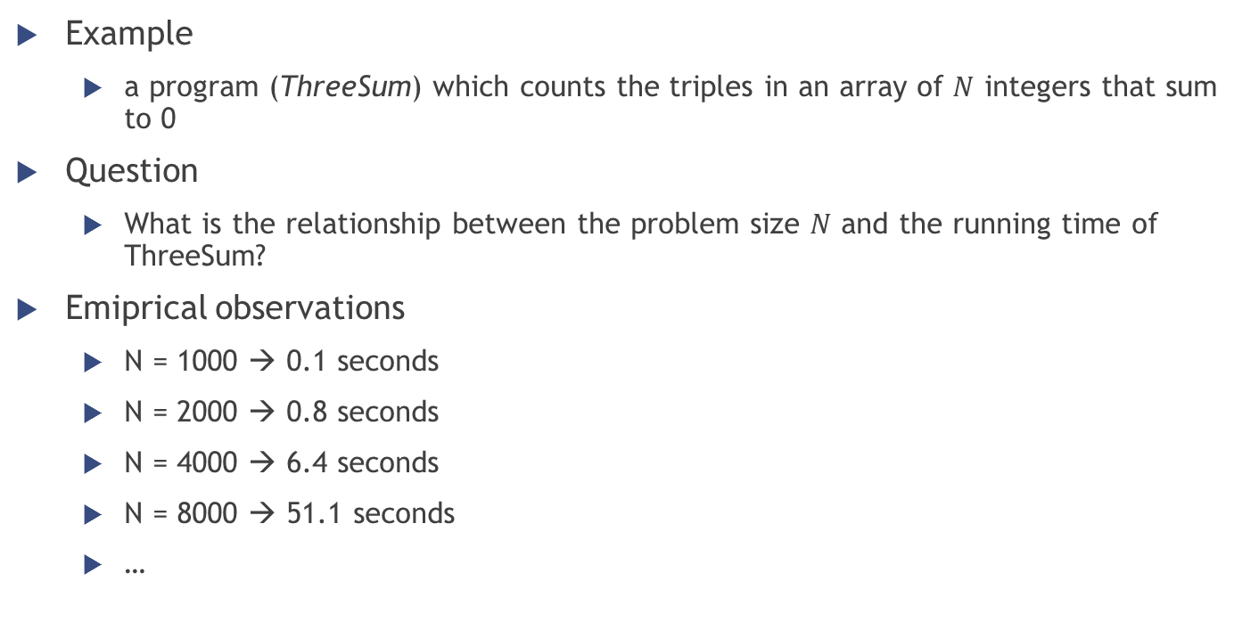
Empirical analysis
Example
a program (ThreeSum) which counts the triples in an array of $N$ integers that sum to 0
Question
What is the relationship between the problem size $N$ and the running time of ThreeSum?
Emiprical observations
N = 1000 → 0.1 seconds
N = 2000 → 0.8 seconds
N = 4000 → 6.4 seconds
N = 8000 → 51.1 seconds
…

Slide 30
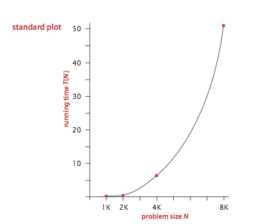
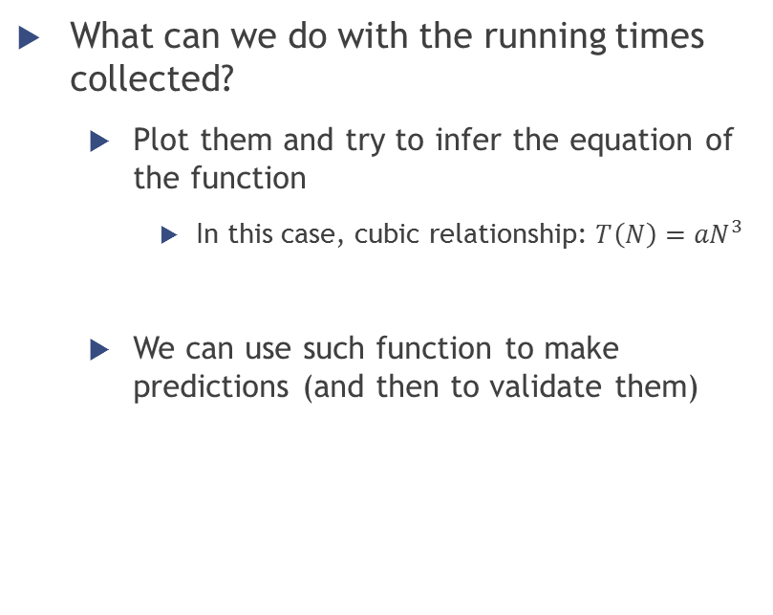
Empirical analysis
What can we do with the running times collected?
Plot them and try to infer the equation of the function
In this case, cubic relationship: ${T\left(N\right)=aN}^{3}$
We can use such function to make predictions (and then to validate them)

Slide 31
Empirical analysis
To get information on the performance of an algorithm, do we need to use the Stopwatch?
No!
It is possible to describe the running time of a program independently of concrete execution, by determining the frequency of execution of statements
Complexity analysis

Slide 32
Complexity analysis
Definition, Intuition, Examples
Notes:
http://bigocheatsheet.com/
http://stackoverflow.com/questions/487258/plain-english-explanation-of-big-o

Slide 33
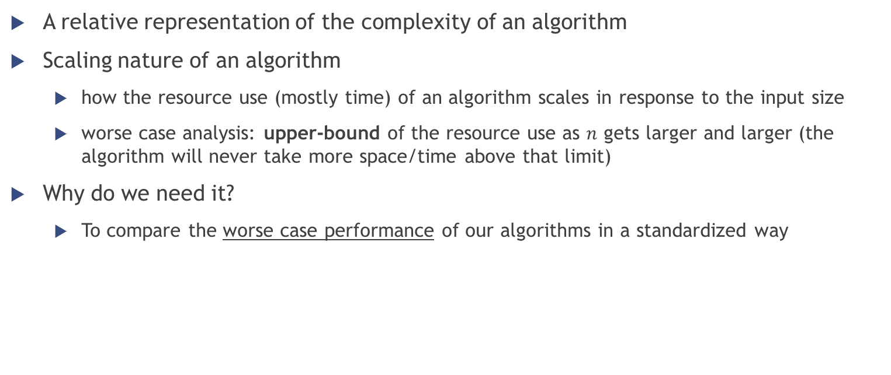
Big O notation
A relative representation of the complexity of an algorithm
Scaling nature of an algorithm
how the resource use (mostly time) of an algorithm scales in response to the input size
worse case analysis: upper-bound of the resource use as $n$ gets larger and larger (the algorithm will never take more space/time above that limit)
Why do we need it?
To compare the worse case performance of our algorithms in a standardized way

Slide 34
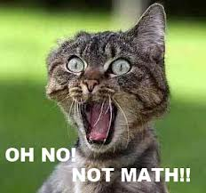
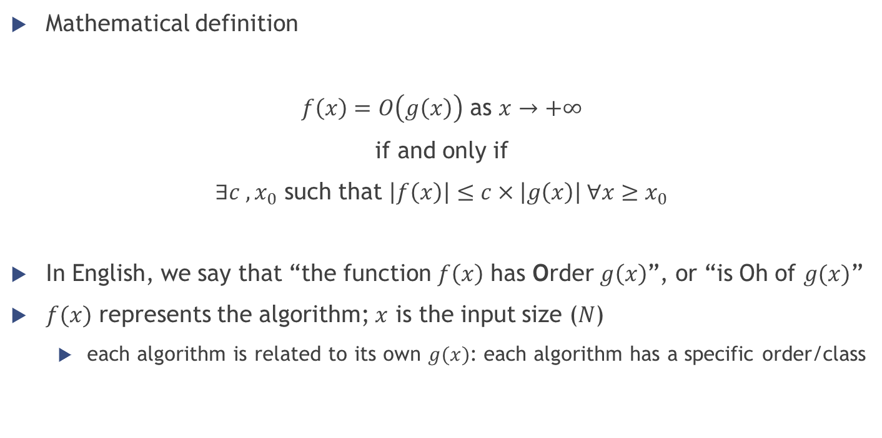
Big O notation
Mathematical definition
$f\left(x\right)=O\left(g\left(x\right)\right)$ as $x→+∞$
if and only if
$∃c , x_{0}$ such that $\left|f\left(x\right)\right|≤c×\left|g\left(x\right)\right| ∀x≥x_{0}$
In English, we say that “the function $f\left(x\right)$ has Order $g\left(x\right)$”, or “is Oh of $g(x)$”
$f(x)$ represents the algorithm; $x$ is the input size ($N$)
each algorithm is related to its own $g(x)$: each algorithm has a specific order/class

Slide 35
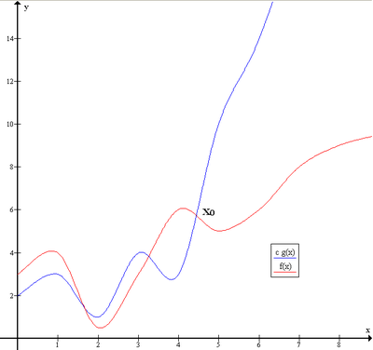

Big O notation
$f\left(x\right)=O\left(g\left(x\right)\right)$ as $x→+∞$
if and only if
$∃c , x_{0}$ such that $\left|f\left(x\right)\right|≤c×\left|g\left(x\right)\right| ∀x≥x_{0}$

Slide 36
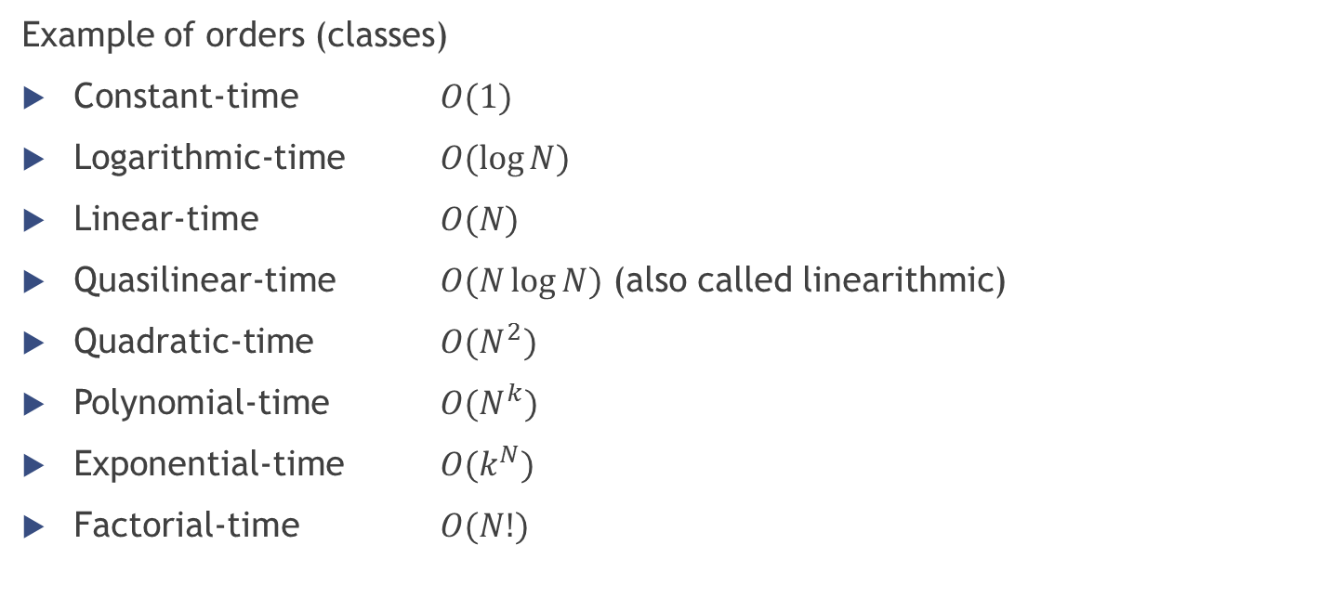
Big O notation
Example of orders (classes)
Constant-time $O(1)$
Logarithmic-time $O(\log{N})$
Linear-time $O(N)$
Quasilinear-time $O(N\log{N})$ (also called linearithmic)
Quadratic-time $O(N^{2})$
Polynomial-time $O(N^{k})$
Exponential-time $O(k^{N})$
Factorial-time $O(N!)$

Slide 37

Big O notation examples
$O(1)$
x[1] + y[4]
================ DIVIDERE IN SLIDES DIVERSE
FOR i = 1 TO 10
x += a[i]
================
int v = a[5]

Slide 38

Big O notation examples
$O(N)$
Summing all the elements of an array
x = 0
FOR i = 0 TO N-1
x += a[i]

Slide 39

Big O notation examples
$O(N)$
Sequential search in an array… remember?
FOR i = 0 TO N-1
IF a[i] = v
RETURN i
RETURN -1

Slide 40

Big O notation examples
$O(N)$
Computing the factorial of a number $N$
$$N!=N×\left(N−1\right)×\left(N−2\right)×…×1$$
Fact(N)
IF N = 0
1
ELSE
N $×$ Fact(N-1)

Slide 41
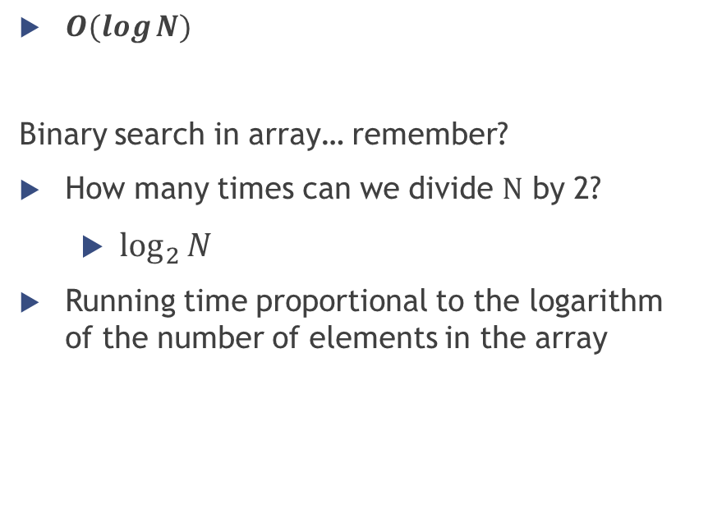
Big O notation examples
$O(\log{N})$
Binary search in array… remember?
How many times can we divide $N$ by 2?
$\log_{2}{N}$
Running time proportional to the logarithm of the number of elements in the array
BinSearch(a, low, high, v)
IF low > high
RETURN -1
middle = (low + high) / 2
IF a[middle] > v
BinSearch(a, low, middle – 1, v)
ELSE IF a[middle] < v
BinSearch(a, middle + 1, high, v)
ELSE
RETURN middle

Slide 42

Big O notation examples
$O(N^{2})$
FOR i = 1 TO N
FOR j = 1 TO N
v += i + j * N

Slide 43

Big O notation examples
$O\left(N^{3}\right)$
int cnt = 0
for (int i = 0; i < N; i++)
for (int j = i+1; j < N; j++)
for (int k = j+1; k < N; k++)
if (a[i] + a[j] + a[k] == 0)
cnt++
SISTEMARE NOTAZIONE FOR

Slide 44
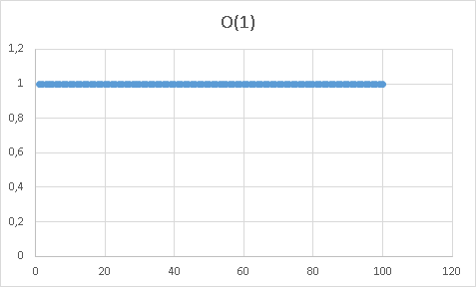
Big O notation comparison

Slide 45
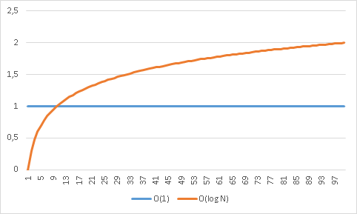
Big O notation comparison

Slide 46
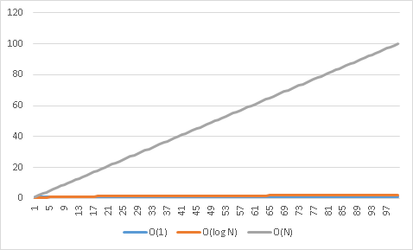
Big O notation comparison

Slide 47
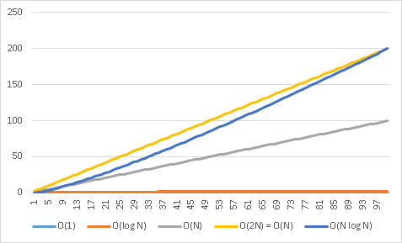
Big O notation comparison

Slide 48
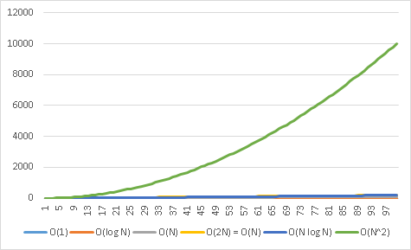
Big O notation comparison

Slide 49
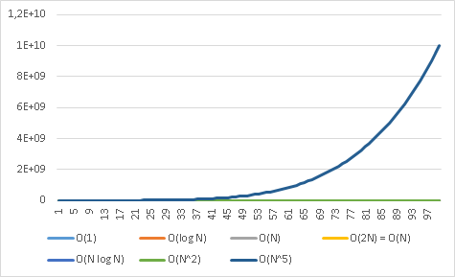
Big O notation comparison

Slide 50
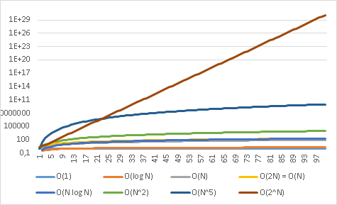
Big O notation comparison

Slide 51
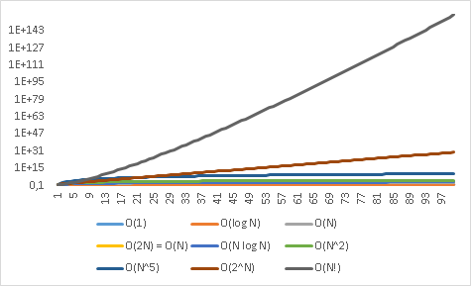
Big O notation comparison

Slide 52
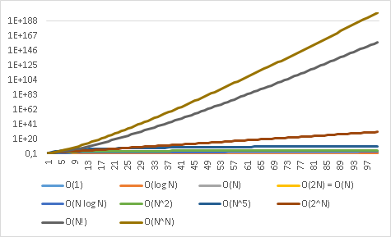
Big O notation comparison

Slide 53
That’s it
See you next week ☺

